Slide 1
The Global Coffee Trade
Luke Pilon: Team Lead and UX Designer
Will Pellegrene: Front-end and UI Developer
Angie Toner: Content and Back-end Developer

Slide 2
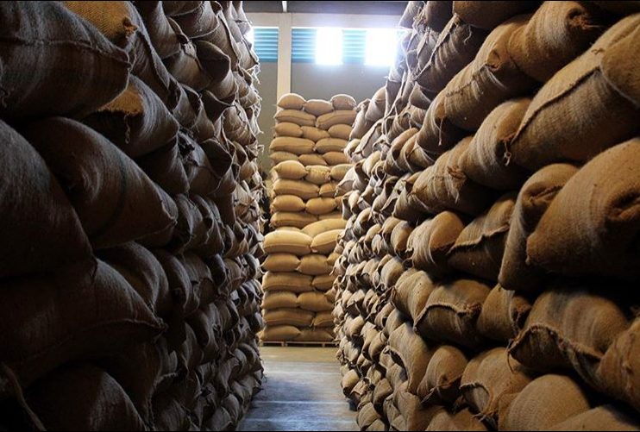
Imports, Exports and Consumption

Slide 3

Data: United States Department of Agriculture and Foreign Agricultural Service
We looked at imports, exports and consumption of green bean coffee from countries all over the world. The data was organized in an Excel Spreadsheet and converted into a JSON file.
Our data was pulled from the USDA Government Site: Last Updated December 2017
http://www.fas.usda.gov/data/coffee-world-markets-and-trade.

Slide 4

Site Goals and Inspiration

Slide 5
We love coffee and coffee culture! It’s community minded and tech savvy.
Community
Technology
Relationships
Story Telling
Local Flavor
Global Village
True Costs and Fair Wages
Web Sites
Ecommerce
Social Media
Learning Tools for Professionals and Coffee Enthusiasts

Slide 6


Olympia Coffee Roasting Company, Olympia WA. https://www.olympiacoffee.com

Slide 7

Aesthetic Inspiration: “Look and Feel”
Organic
Botanical
Modern
Industrial
Process Oriented

Slide 8
Phase 1: UI Technologies
Framework Used: Bootstrap
Font Selection: Dafont.com
Color Palette made on Colorhex.com

Slide 9
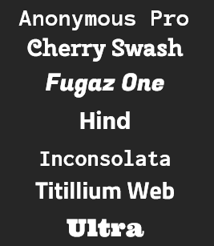
Font Selection:

Slide 10
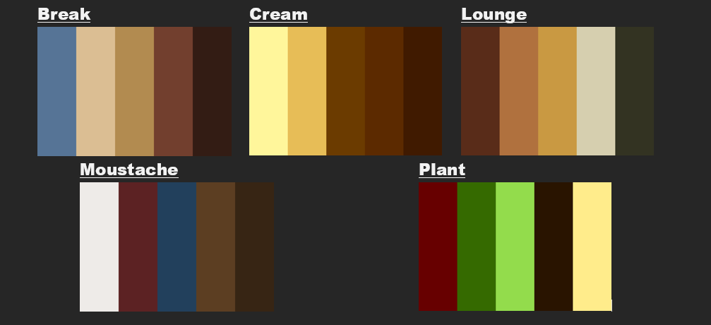
Thematic Color Palette:

Slide 11
Working with Bootstrap:
Perks of Bootstrap
More organized
Saves time on styling
API makes coding more efficient

Slide 12
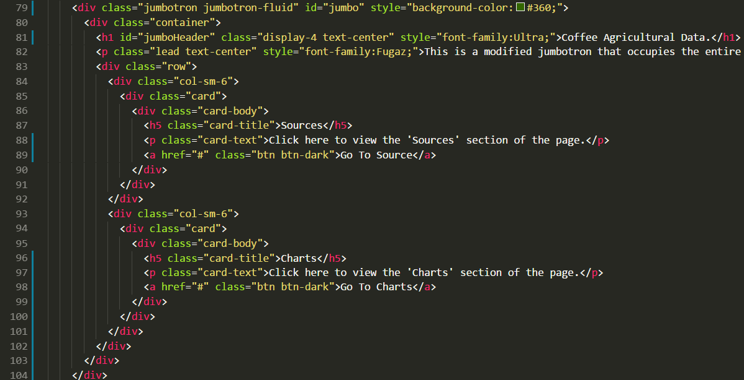
Code Sample: Bootstrap

Slide 13
Thoughts behind the Design:
Display the data graphs all on one page since the applications focus is solely on displaying data
Color palette is based on the colors of a coffee plant since the subject of the project is coffee agriculture

Slide 14
Charting Tools:
Chart.js used to generate our bar chart and our pie chart. These graphs explore green bean production and consumption
Google Charts is used in our global map which looks at imports and exports

Slide 15
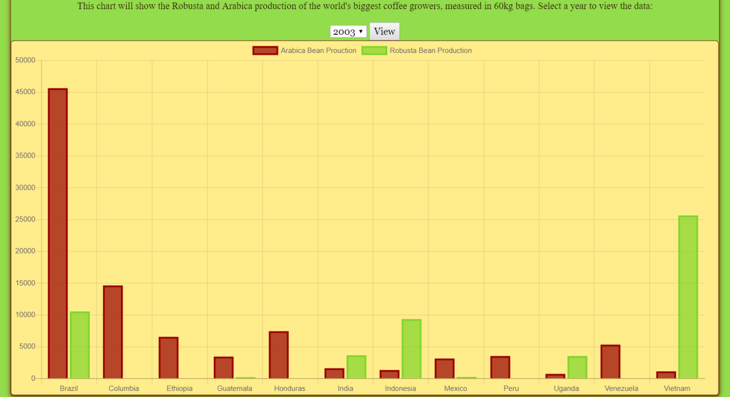
Chart.js

Slide 16
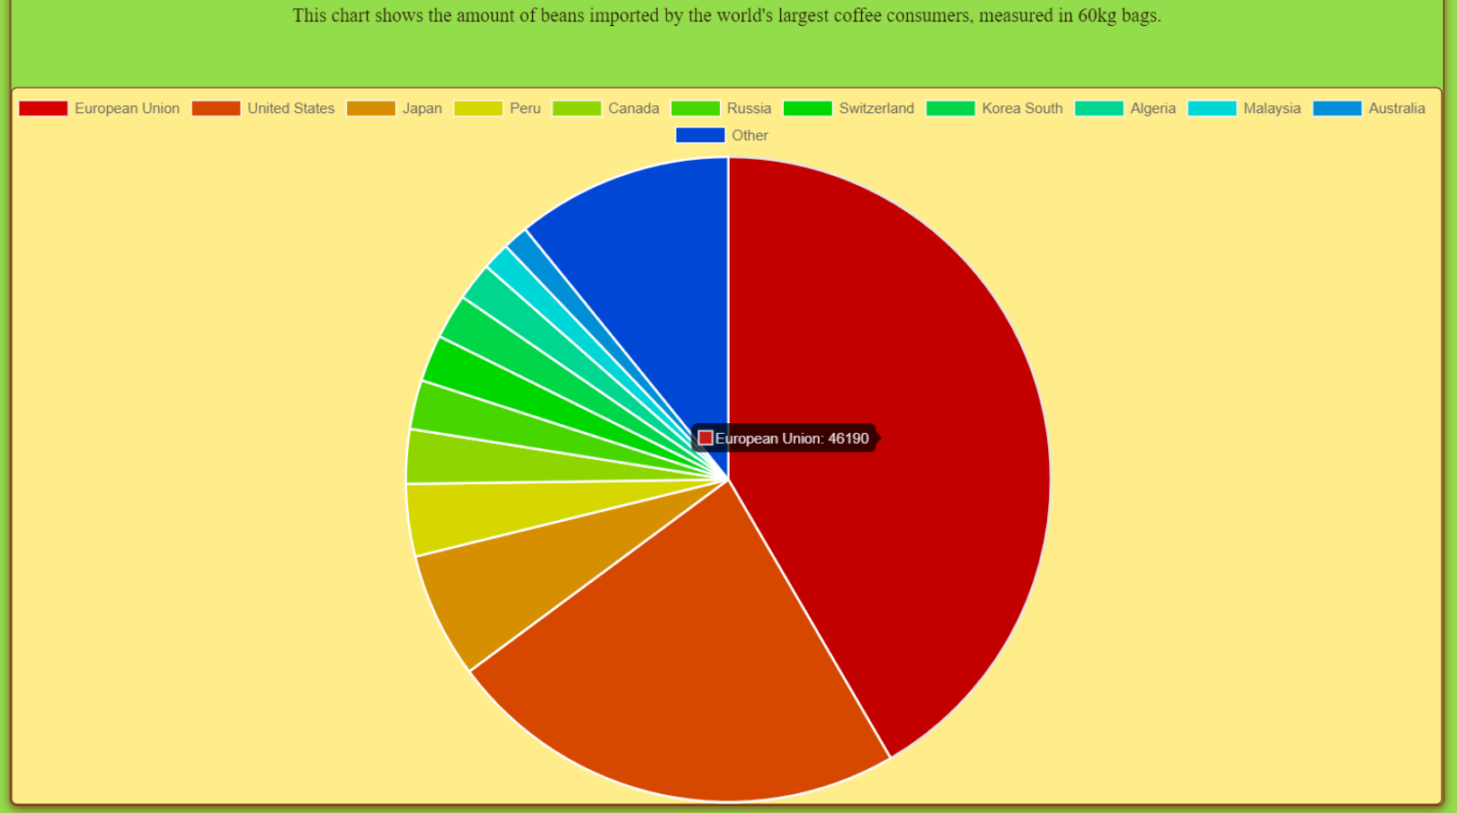
Chart.js

Slide 17
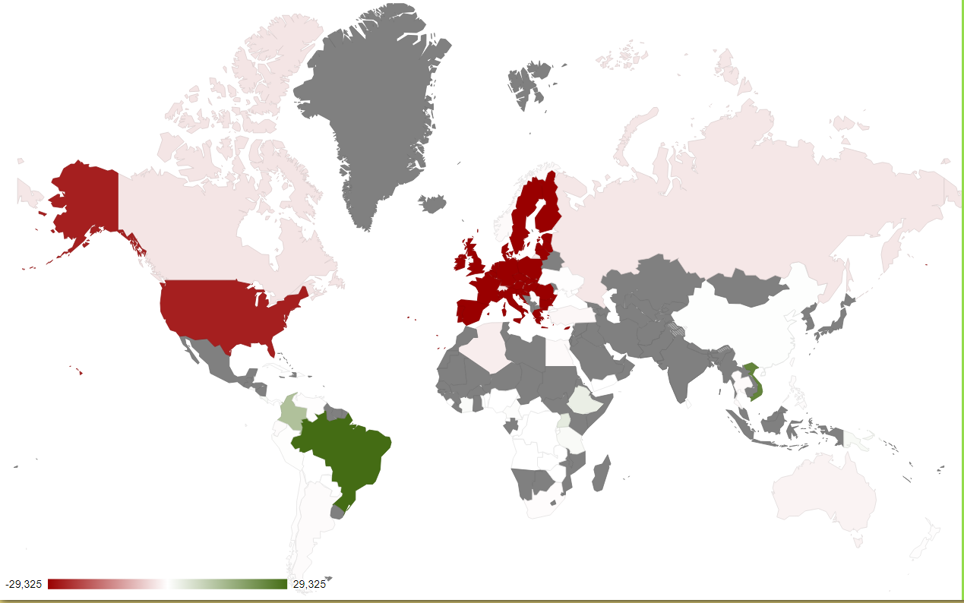
Google Charts

Slide 18
Programming Logic and Design:
By definition: Bubble Sort is a sorting algorithm in which list elements are arranged in ascending or descending order by comparing items in pairs and swapping them when they are out of order
The algorithm, which is a comparison sort is named for the way smaller or larger elements “bubble” to the top of the list.
Simple and slow, sometimes referred to as a “sinking sort”

Slide 19
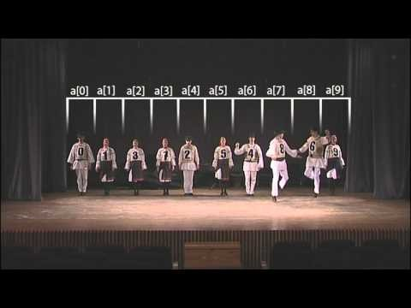
Sorting Algorithm: Bubble Sort

Slide 20
Understanding Bubble Sort:
A Constant is declared to hold an array’s size
An Array is declared to hold data values
Once the condition is met, the sort is complete
3 Main Procedures
Input
Sort
Display

Slide 21
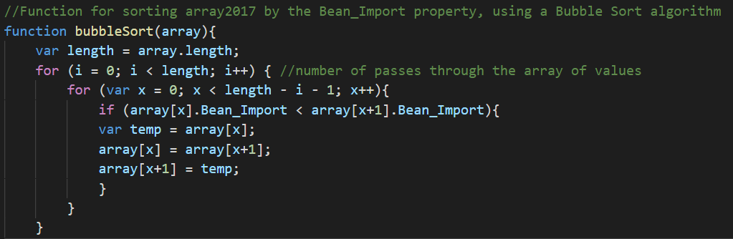
Bubble Sort Code

Slide 22
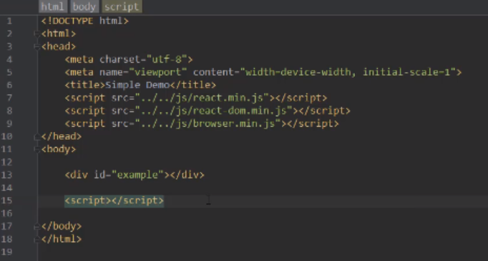
Phase 2: Introducing the React Library

Slide 23
React: History, Methodology, Benefits
React was created by Jordan Walke, a software engineer at Facebook in 2011 and further developed with Instagram in 2012. Initial release, March 15’.
This JavaScript Library is used to develop single-page applications and mobile applications.
It’s popularity stems from it’s scalability, simplicity and speed.
It’s primary use is building User Interface.

Slide 24
React Development Environment:
Nodejs is the glue that makes the development environment work, NPM manages dependencies and ties together the steps between JSX and JavaScript
Babel is our JavaScript transpiler, this helps us work more consistently with older browsers
Webpack is our module bundler, it bundles all relevant parts of the React library, the JSX and JavaScript into a single file.

Slide 25
JSX: when it reaches our browser, in gets turned into pure JavaScript!
There are some nit picky rules:
You can only return a single root node
You cannot specify CSS inline
There are key words, an example: class → use, className
Comment often and if the comment is connected to a child of a tag, wrap it in
{ /*curly brakets*/ } ensuring it is parsed as an expression

Slide 26
React Concepts:
One way data flow with props (rendering w/o data)
Two way data flow with states (manipulating data)
Component hierarchy
JSX
Virtual DOM
Spread Operations

Slide 27
Web Components:
Allows for modularization
Chunks of JavaScript that output (via JSX) HTML elements
Components can be combined to create more complex components, they can have children
It eliminates duplicate code
“Box within a box” theory
Argument is to function as is properties to components..

Slide 28
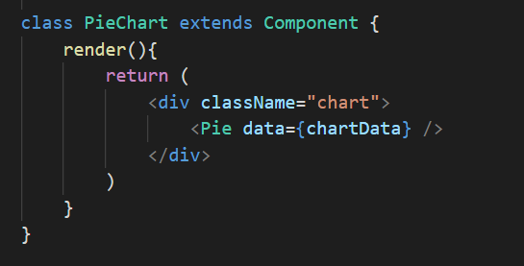
Web Component Example

Slide 29
Transferring Properties:
React enforces a chain of commands where properties have to flow from parent to an immediate child component
No skipping a layer of children
Children cannot send a property back to the parent
All communication moves in one direction

Slide 30
Spread Operator:
The spread operator allows you to unwrap an array into its individual elements.
var items = [“1”, “2”, “3”];
function printStuff (a, b, c) {
console.log(“Printing: “ + a + “ ” + b + “ “ + c);
Common way of doing this:
printStuff (items[0], items[1], items[2]);
Or, access each array item individually and pass it in to the printStuff function.
printStuff(…items);

Slide 31
More on the Spread Operator: <Display {…props}/>
In a Component:
Passing to a child component:
var props = {
color: “steeleblue”,
num: “3.14”,
size: “medium”
}
<Display color={this.props.color}
num={this.props.num}
size={this.props.size}/>

Slide 32
Event Handling:
In React you both specify the event you are listening for and the event handler that will get called, all inside your markup
Events pass arguments that are specific to the type of event you’re dealing with, with React you have a type called SyntheticEvents
Each SyntheticEvent gets a Property Name and a Type
For further info on Event System documentation: (http://facebook.github.io/react/docs/events.html)

Slide 33
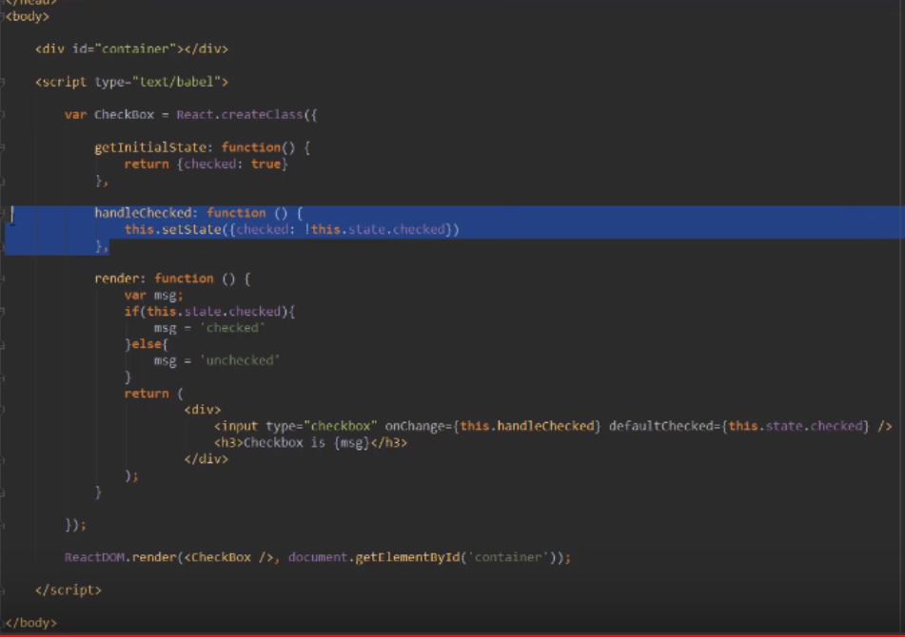
Event Handling and Set State:

Slide 34
The Component Lifecycle:
Initial Render: when your component is about to start its life, it’s off and on it’s way to the DOM.
State Change: this helps ensure latest version of itself, when there is state change-the lifecycle methods get called.
Props Change: most importantly, it returns an argument, an object that holds new prop values.
Unmount: removing the component from the DOM

Slide 35
Initial Render: Methods
getDefaultProps: Specify default with this.props, this is the very first thing to be called, before your component is ever created.
getInitialState: Specify default value of this.state, again before the component is created.
componentWillMount: This is the last method to be called before your component gets rendered to the DOM.
render: Every component must have a render call, even if you wish to return a null or false.
componentDidMount: Your component has been rendered and placed on the DOM.
With the exception of the Render Method, all of these are only called once.

Slide 36
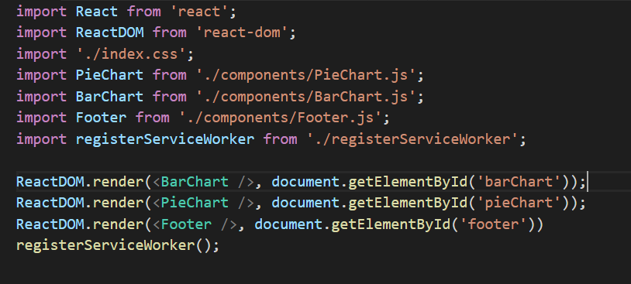
Initial Render Function:

Slide 37
State Change:
When a state change happens, all the lifecycle methods get called.
shouldComponentUpdate: This method allows you to control updating.
componentWillUpdate: This method gets called to update components.
render: Called to render
componentDidUpdate: If there is any code to update after render, here’s the place to stash it.

Slide 38
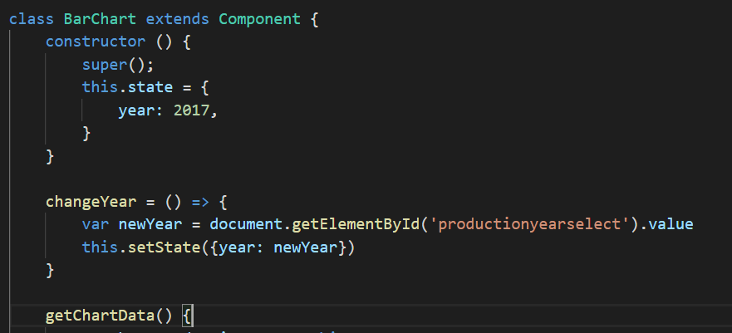
Setting State Change:

Slide 39
Props Change:
Components update when prop values change after it’s been rendered in the DOM. These will look familiar, we saw this in State Change.
componentWillReceiveProps:
shouldComponentUpdate:
componentWillUpdate:
render:
componentDidUpdate:

Slide 40
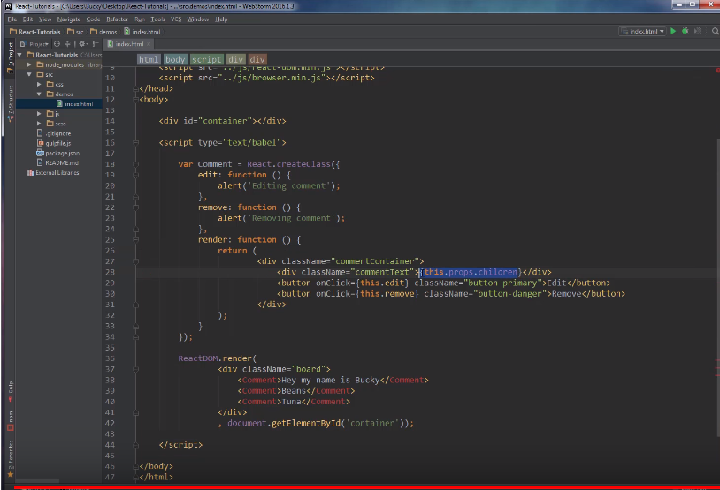
Passing data and props:

Slide 41
Unmount
Only one lifecycle method is active when a component is about to be retired, destroyed = removed from the DOM.
componentWillUnmount: clean up includes,
Remove event listeners
Stop timers
Ect…

Slide 42
We Build, we learn, we grow!
Thank you for your attention and time,
we hope this gets you started-
Gets you started asking questions and thinking about
what you might like to build with React.

Slide 43
Notable Influence:
Learning REACT by Kirupa Chinnathambi
Programming Logic and Design, 8th Edition by Joyce Farrell
https://www.youtube.com/playlist?list=PL6gx4Cwl9DGBuKtLgPR_zWYnrwv-JllpA Getting Started with React
https://www.youtube.com/watch?v=Ly-9VTXJlnA Charts.JS and React
Wikipedia and YouTube

